Slide 1
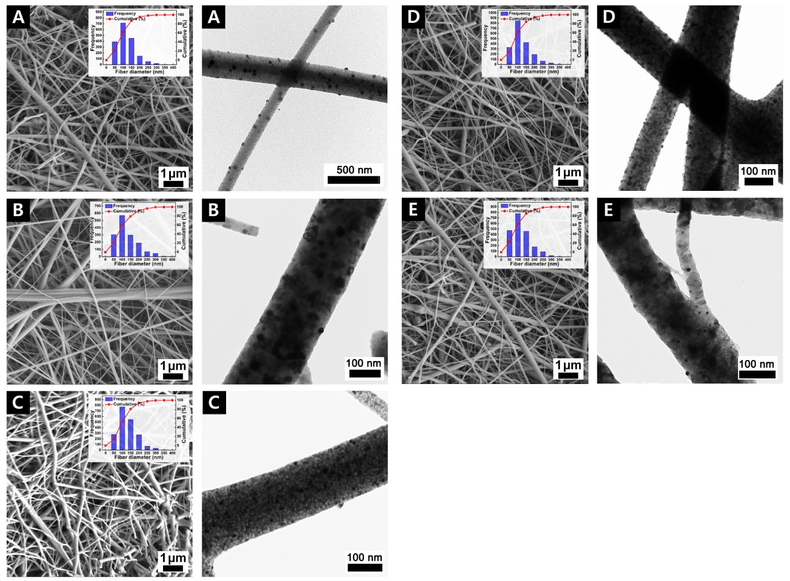
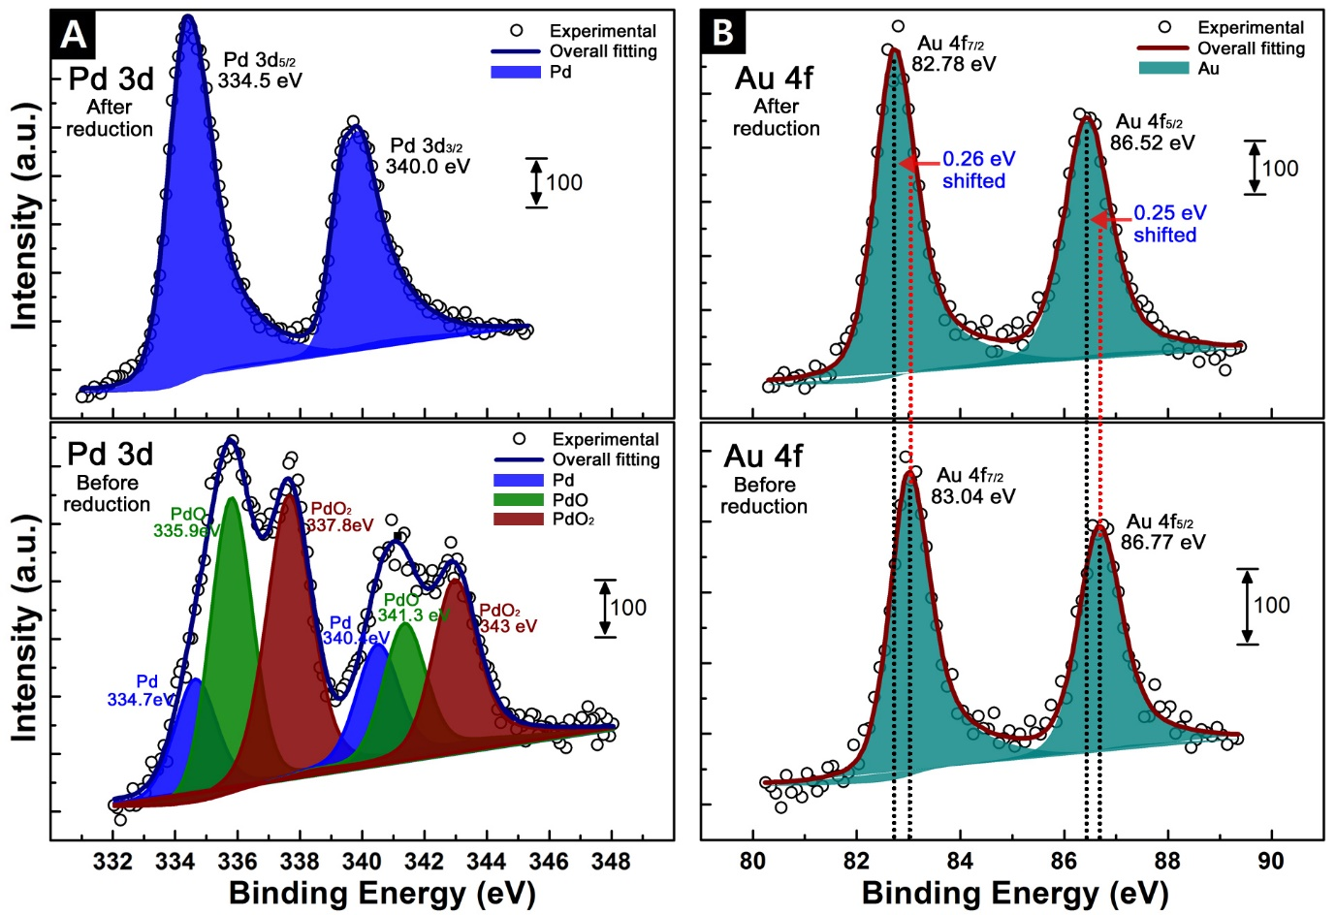
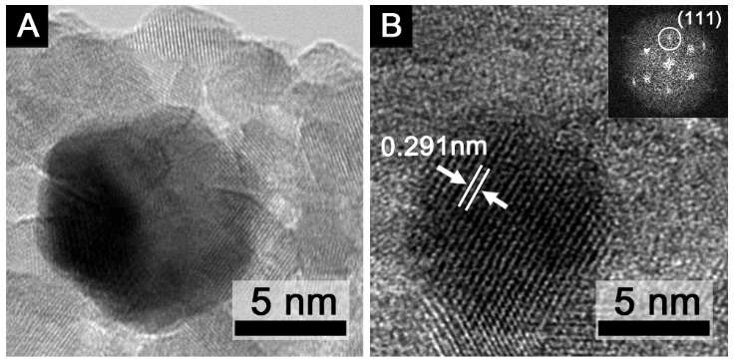
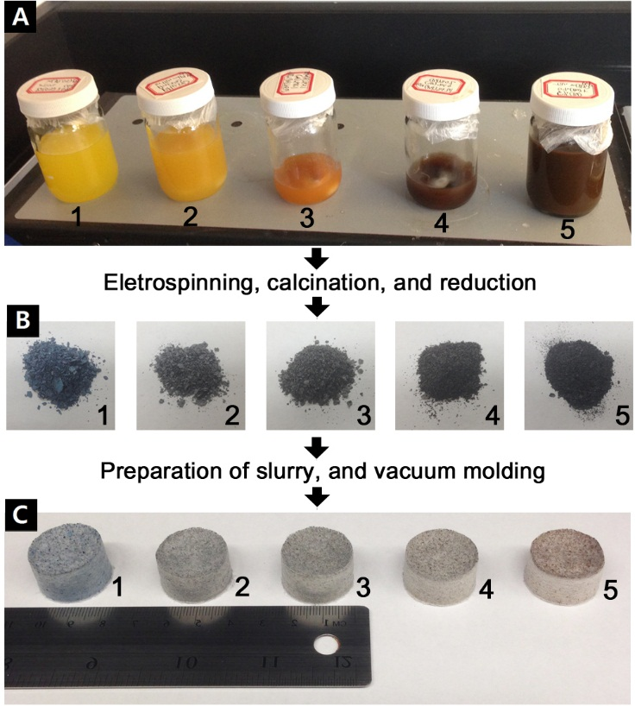
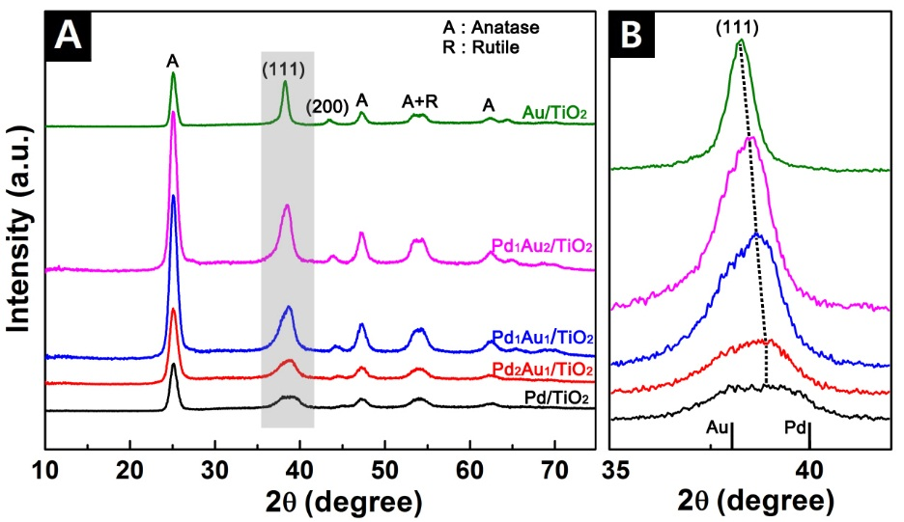
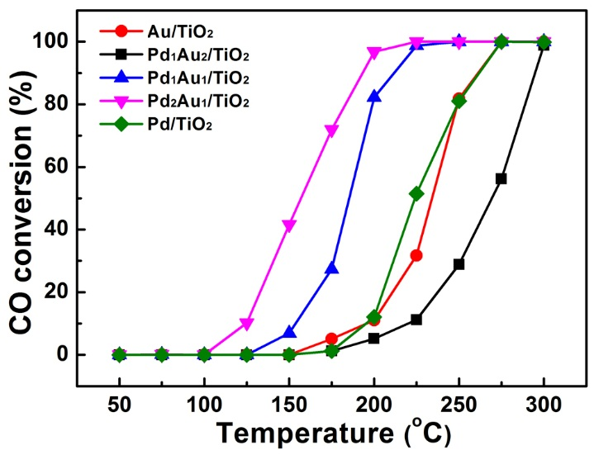
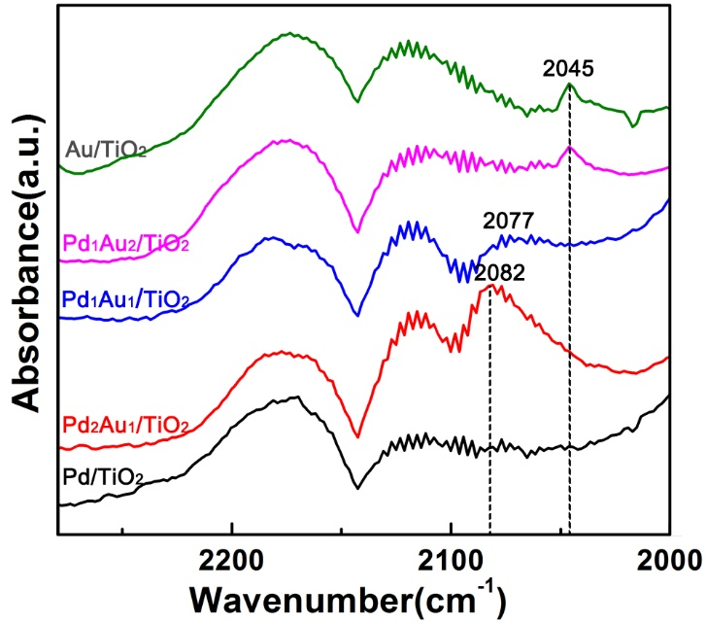
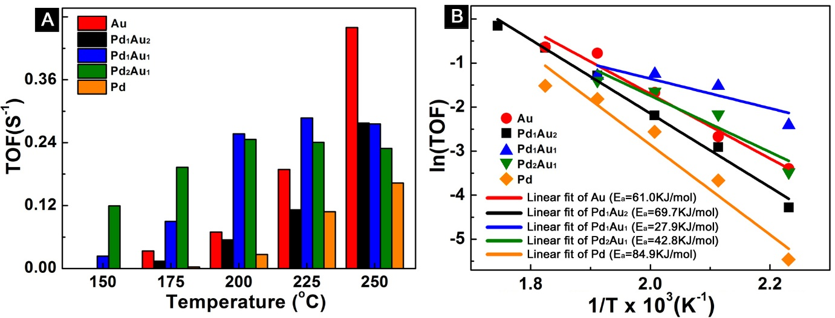
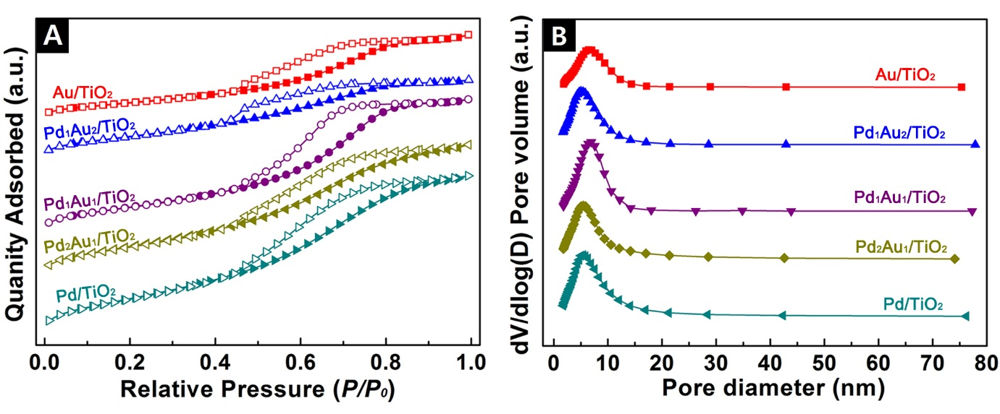
11
Carbon Monoxide over Pd-Au Alloy Nanoparticle doped Fibrous TiO2 Fiber Media
Hyeon Ung Shin, Dinesh Lolla, Ahmed Abutaleb, and George G. Chase
EDX)
RESULTS AND DISCUSSION
ABSTRACT
RESULTS AND DISCUSSION
Pd-Au nano-sized alloy catalysts supported on TiO₂ submicron-sized fibers have been developed by electrospinning, calcination of the polymer template fibers, and hydrazine reduction. The morphologies, crystal structure, and textural properties (surface area, pore size, and volume) of Pd-Au/TiO₂ fibers materials were evaluated with electron microscopy (SEM, TEM, and HRTEM), X-ray Diffraction(XRD), and BET nitrogen adsoprtion. For the alloy effect induced by the Pd-Au formation, the ensemble (geometric) effect and ligand effect (charge transfer) in Pd-Au nanoparticles were investigated with X-ray photoelectron spectroscopy (XPS) and Fourier transform infrared spectroscopy (FTIR) to understand the formation of alloyed Pd-Au particles of different metal composition with consequent modification of their electronic and geometric properties.
The catalytic activity of these materials were tested in carbon monoxide oxidation reaction using a plug-flow reactor. The results showed that the performance was optimal for a catalyst of composition Pd₂Au₁ molar ratio that was active at 125°C, which had higher dispersion of active components and better catalytic performance compared to monometallic particle Au/TiO₂ and Pd/TiO₂ fiber media. Moreover, the improved reaction activity of Pd₂Au₁/TiO₂ fiber medium was attributed to a decreased in the activation energy.
- Microscope Study (SEM, TEM)
- X-ray Photoelectron Spectroscopy (XPS)
Figure 3. SEM (left column, Top right inset : Fiber size distribution) TEM (right column) images for (A) Au/TiO₂, (B) Pd₁Au₂/TiO₂, (C) Pd₁Au₁/TiO₂, (D) Pd₂Au₁/TiO₂, and (E) Pd/TiO₂
Figure 6. XPS peaks of Pd 3d (A) and Au 4f (B) after and before reduction
EXPERIMENTS
- Transmission Electron Microscope (HRTEM, SAED)
$$A=πr^{2}$$
- X-Ray Diffraction Study (XRD)
Figure 7. HRTEM images of Pd₂Au₁ particle (A) after calcination in air at 550°C for 4 hours (B) after consequent reduction (inset : FFT pattern
Figure 1.
Overall preparation procedures
of 2.3cm fibrous fiber media based on catalytic nanoparticles (Au, Pd, or
Pd-Au) doped TiO₂ submicron sized
fiber.
Step (A) : electrospinning solutions,
Step (B) : electrospinning, calcination,
and reduction of only Au, Pd, or
Pd-Au/TiO2
Step(C) : catalytic media out of
Catalytic submicron sized TiO2 fibers
and Al2O3 microfibers [(1) Au/TiO₂,
(2) Pd₁Au₂/TiO₂, (3) Pd₁Au₁/TiO₂,
(4) Pd₂Au₁/TiO₂, and (5) Pd/TiO₂]
Figure 4.
X-ray
diffraction
peaks of Au/TiO₂, Pd-Au/TiO₂, Pd/TiO₂
- Catalytic Performance
A
B
- Brunauer, Emmett, and Teller Surface Area (BET)
Table 2. Textural properties of Pd-Au/TiO2, Au/TiO2, and Pd/TiO2 fibers
Material | SSAª (m²/g) | Pore diameter^{b} (nm) | Pore width^{c} (nm) | Pore volume^{d} (cm3/g)
Au/TiO₂ | 55.5 | 5.5 | 6.1 | 0.085
Pd₁Au₂/TiO₂ Pd₁Au₁/TiO₂ | 72.5 87.6 | 4.3 5.3 | 4.5 6.1 | 0.078 0.134
Pd₂Au₁/TiO₂ Pd/TiO₂ | 103.3 115.2 | 4.8 4.9 | 5.2 5.5 | 0.132 0.156
Figure 8. (A) CO conversion (%) of Pd-Au doped TiO2 fiber media and (B) FT-IR spectra for CO chemisorbed on Au/TiO2, Pd/TiO2, and Pd-Au/TiO2 fiber media
RESULTS AND DISCUSSION
Table 1.Fiber size, particle size, composition and metal loading
Material | Fiber size (nm) | Particle size (nm) | Paticle composition | Metal loading(wt %)
Au/TiO₂ | 119±53 | 19.8±1.9 | Au | 5.3
Pd₁Au₂/TiO₂ | 124±57 | 14.2±1.7 | Pd₃₅Au₆₅ | 4.9
Pd₁Au₁/TiO₂ | 107±51 | 9.3±1.1 | Pd₅₂Au₄₈ | 4.7
Pd₂Au₁/TiO₂ | 99±49 | 7.2±0.8 | Pd₆₈Au₃₂ | 5.0
Pd/TiO₂ | 105±55 | 8.5±0.6 | Pd | 4.8
Figure 9. (A) Turnover frequency (TOF) and (B) Arrhenius plots for CO oxidation
ªBET specific surface area, ^{b}BJH adsorption average pore diameter, ^{c}adsorption average pore width, ^{d}BJH adsorption cumulative volume of pores
Figure 5.
(A) N₂ adsorption-desorption isotherms and
(B) BJH pore size distribution curves of Pd-Au/TiO2 nanofibers
- Energy Dispersive X-Ray Analysis (EDX)
CONCLUSION
Figure 2. SEM-EDX mapping of Pd₂Au₁/TiO₂ fibers
- The Synergetic effect induced by the Pd-Au alloy formation could strongly influence the Pd-Au particle size and catalytic performances.
- The decrease of the particle size achieved by the alloy Pd-Au (Pd2Au1 and Pd1Au1) could avoid the growth of metal particles.

